Slide 1
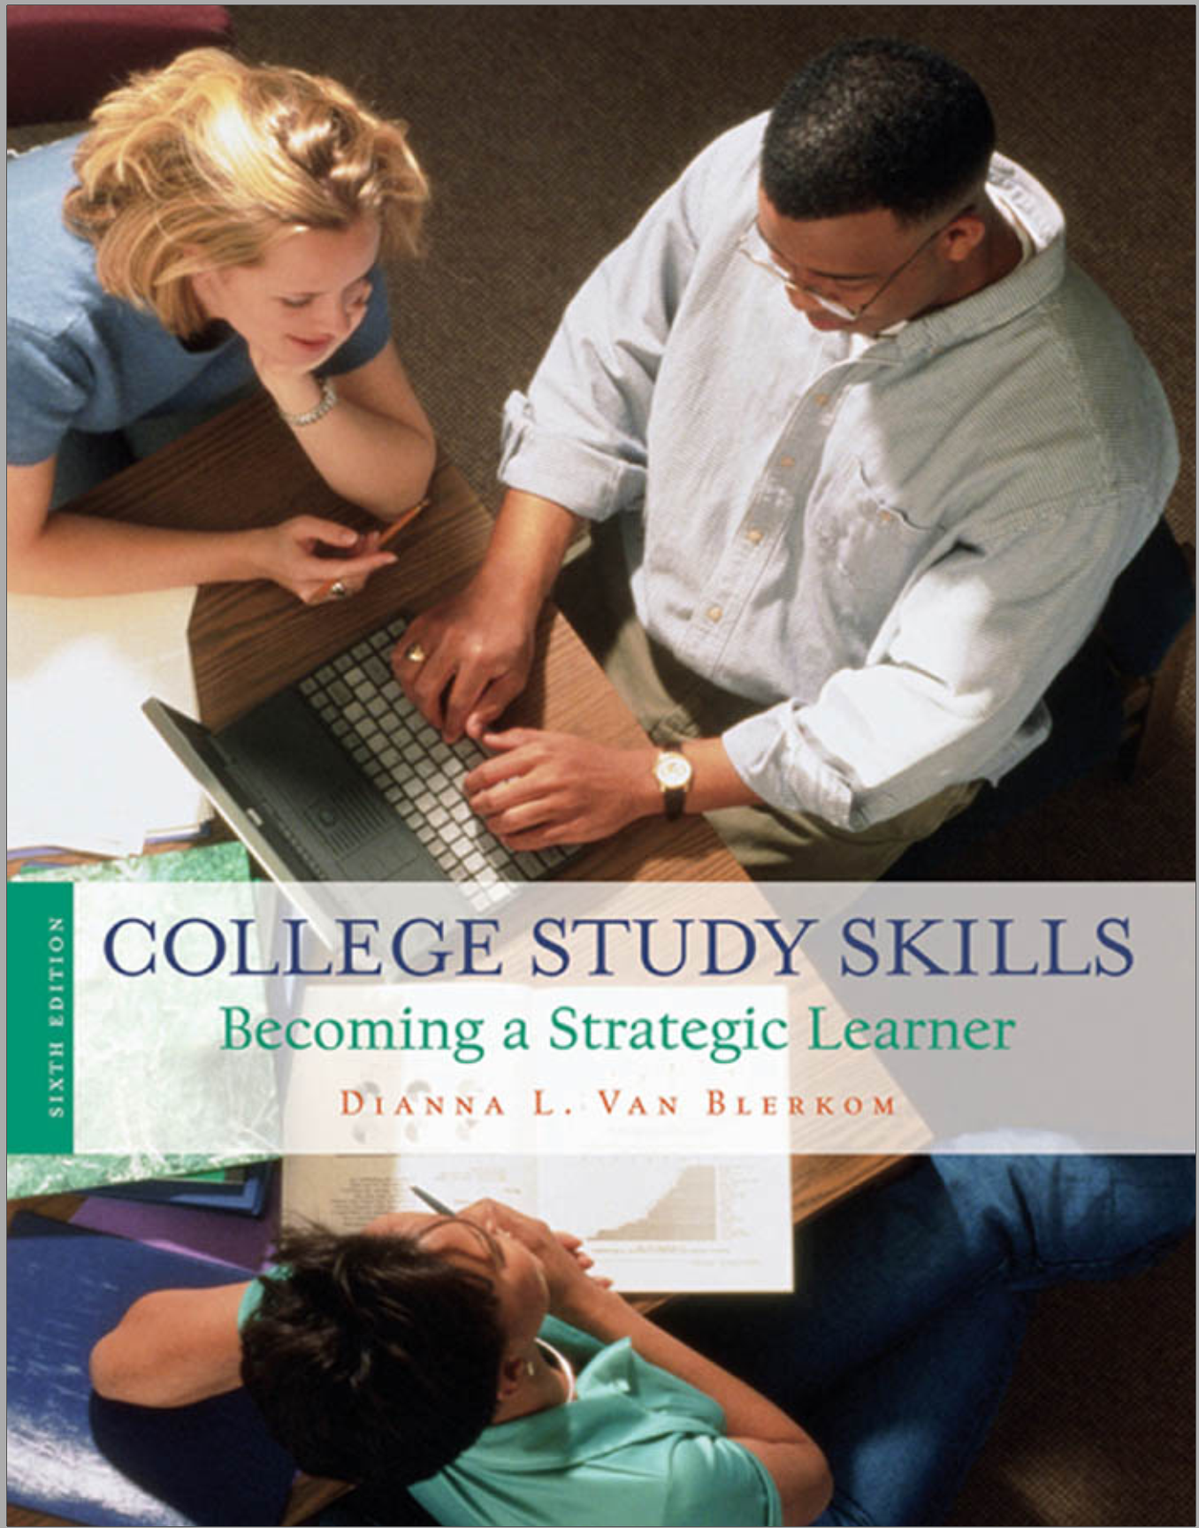
Study Skills and Critical Thinking
Chapter 4
Memory and Learning

Slide 2
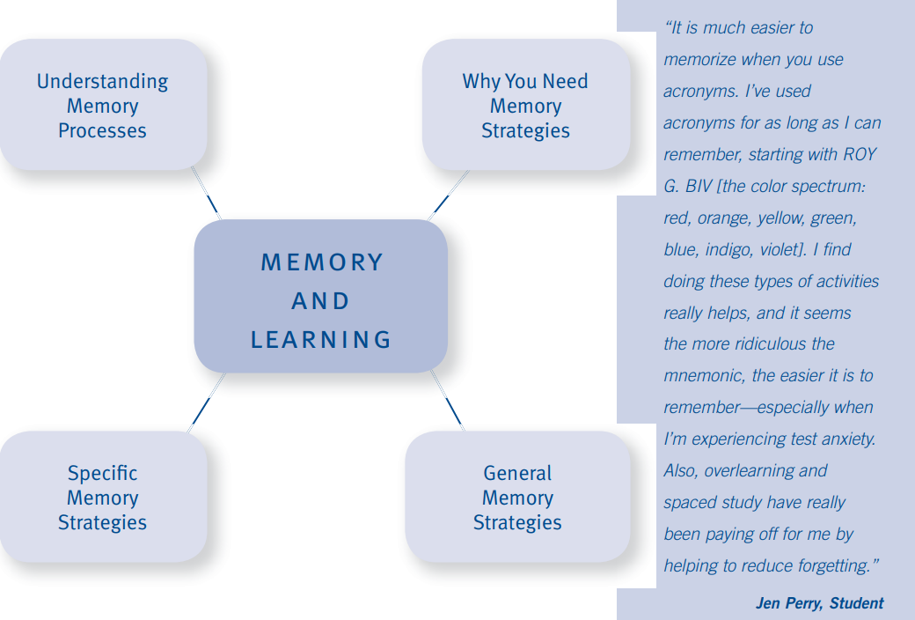

Learning Objectives

Slide 3
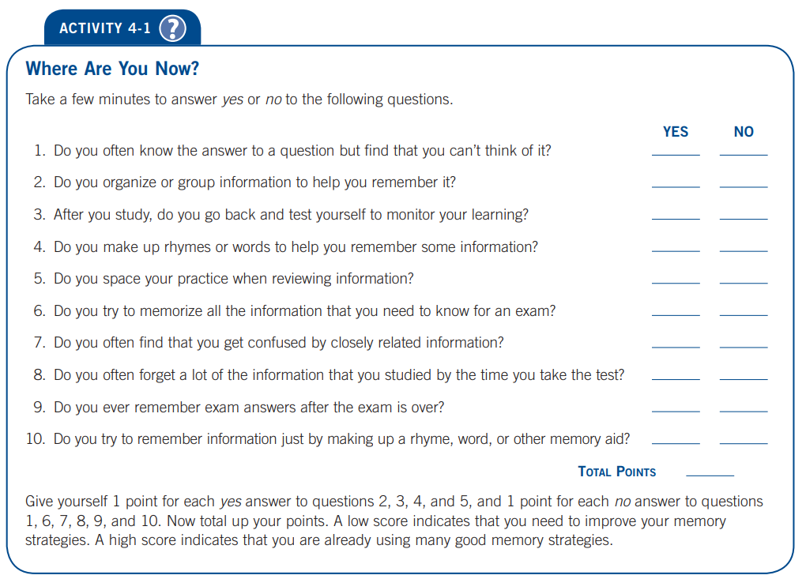

Slide 4
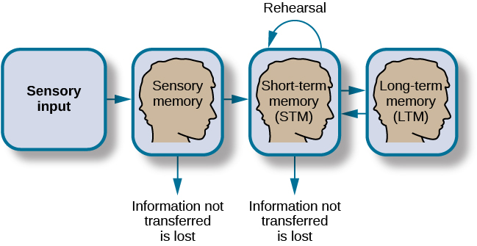
Understanding Memory Processes
Doing well on exams requires an effective study plan, active study strategies, and a good memory
One of the most useful of these is the Information Processing Model.
“Having a good memory” involves both putting information into memory and getting it back out—both storage and retrieval.

Slide 5
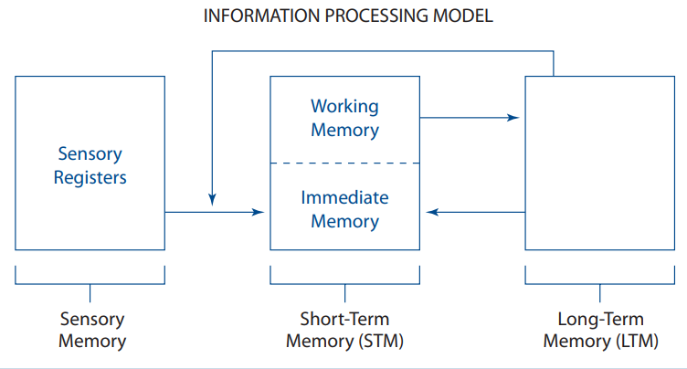
Understanding Memory Processes
Information Processing Model
The Information Processing Model suggests that memory is complex and consists of various processes and stages. For example, there are at least three types of memory:
Sensory memory,
Short-term memory (STM), and
Long-term memory (LTM).

Slide 6
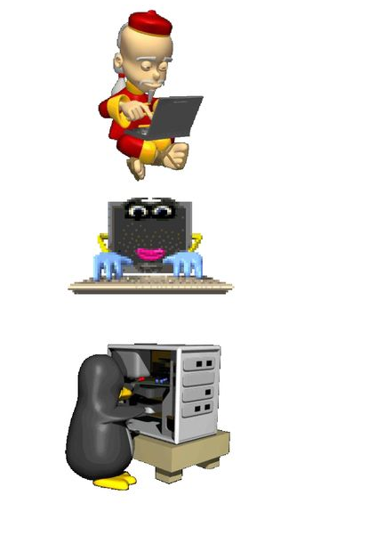
Understanding Memory Processes
The first step in this process is encoding—interpreting information in a meaningful way.
The second step in the memory process, storage, involves working on (for example, repeating and organizing) information so that it can be placed into LTM.
The third step, retrieval, involves getting information out of LTM.

Slide 7

Understanding Memory Processes
1. Sensory Memory
Sensory memory, also known as the sensory registers, Essentially, our senses (vision, hearing, smell, taste, and touch) are always very busy.
We hear, see, smell, taste, and touch hundreds of stimuli each moment. Most of these stimuli are unimportant and are therefore quickly forgotten.

Slide 8
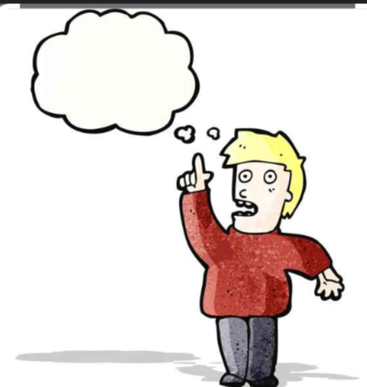
Understanding Memory Processes
2. Short-Term Memory
Short-Term Memory is the process that goes from the sensory registers to the immediate memory.
Short-term memory has two components:
Immediate memory and
Working memory

Slide 9
Understanding Memory Processes
Immediate memory is related to the concept of consciousness. Whatever you currently are thinking about is in your immediate memory.
Working Memory. To hold on to information and get it into your long-term memory, you must first move the material into the other part of your short-term memory, the working memory

Slide 10
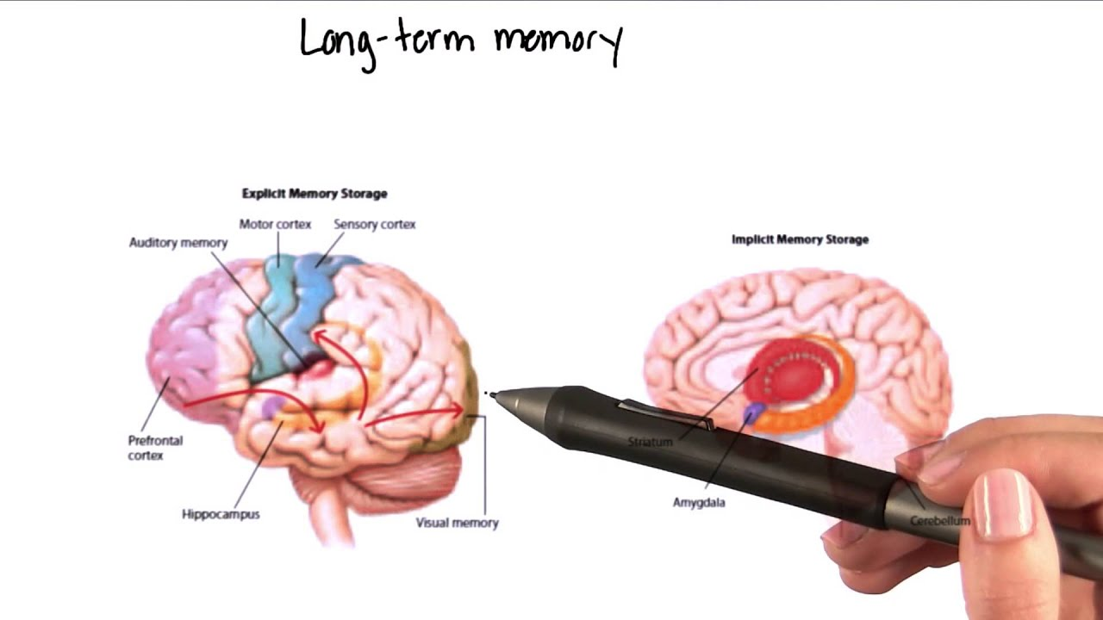
Understanding Memory Processes
3. Long-Term Memory
Once material has been processed in working memory, it can be moved into long-term memory.
Long-term memory has an almost unlimited capacity.
We also rely on our LTM to encode new information.
https://www.youtube.com/watch?app=desktop&v=wUetGsGJt4c

Slide 11

WHY YOU NEED MEMORY STRATEGIES
According to Kenneth Higbee, “remembering is hard work, and memory techniques do not necessarily make it easy, they just make it more effective.”
To perform well in college courses, you need to use strategies that aid the acquisition, retention, and retrieval of the information that you want to learn.

Slide 12

WHY YOU NEED MEMORY STRATEGIES
Retrieval and Forgetting
There are a number of memory problems that lead to forgetting.
Never really learned it.
Not understanding the information.
Cramming.
Stored with too few cues
Interference.
Test Anxiety.
Notes:
Retrieval and Forgetting
Never really learned it. As you read earlier, many students think that reading over material a few times will ensure their memory of it for the exam.
Not understanding the information. Even if you practice information seven or eight times, you can’t learn it if you don’t really understand it.
Cramming. When you cram for a test, you try to learn all of the information during one long study session. This often leads to practicing the information only one or two times.
Stored with too few cues. If you learn something, it’s available to you in your LTM; however, it may not be accessible. Many times you need a key term, or what psychologists call a cue, a label, a hook, or link to the information, to unlock the memory.
Interference. Studying closely related information often leads to interference.
Test Anxiety. Test anxiety also affects retrieval. When you’re anxious, it’s more difficult to recall cues and retrieve important information because anxiety affects your ability to focus and concentrate.

Slide 13
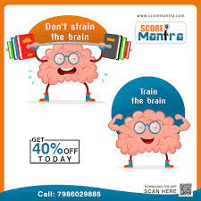
GENERAL MEMORY STRATEGIES
Spaced Practice vs. Massed practice
The following general strategies can help you acquire, retain, and retrieve course information.
There are many benefits to using spaced practice instead of massed practice.
Massed practice, like cramming, involves studying all the material at one time.
Spaced practice, involves spacing your study time over a longer period, with breaks between practice sessions

Slide 14
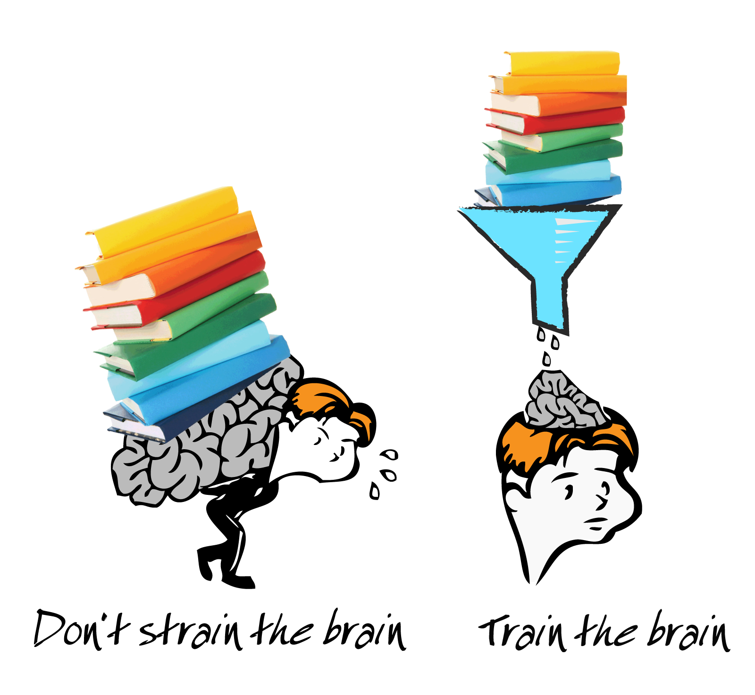
GENERAL MEMORY STRATEGIES
Break Tasks Down
Instead of trying to learn all of the material for your exam at one time (cramming), study only one or two chapters (and the accompanying lecture material) each day.
By breaking down study tasks and organizing and storing small units of material, you increase the likelihood that you’ll efficiently and effectively store the material in your LTM.

Slide 15
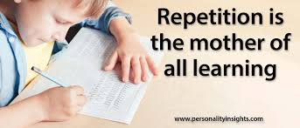
GENERAL MEMORY STRATEGIES
Repetition (many forty or more times).
The more times you open that same drawer and pull out that same folder, the easier it is to do it the next time; you know just where to go in the LTM warehouse and exactly where in the filing cabinet to look.
If you continue to practice that same material over a period of days, you’ll be able to strengthen and maintain your memory of it

Slide 16

GENERAL MEMORY STRATEGIES
Overlearning
Overlearning is an important strategy for test preparation.
Overlearning involves continuing to work on material even after it’s learned—after it’s stored in LTM.
Overlearning information will also help you retrieve the information more quickly, because you practice using the cues you created to find the answers in LTM

Slide 17
SPECIFIC MEMORY STRATEGIES
Weinstein and Mayer describe five groups of learning strategies:
Rehearsal strategies,
Elaboration strategies,
Organizational strategies,
Comprehension monitoring strategies,
Affective and motivational strategies.

Slide 18

SPECIFIC MEMORY STRATEGIES
Weinstein and Mayer describe five groups of learning strategies:
Rehearsal strategies
Rehearsal strategies involve practicing the material until it is learned.
All learning strategies involve rehearsal of some type, but there are two different types of rehearsal strategies

Slide 19
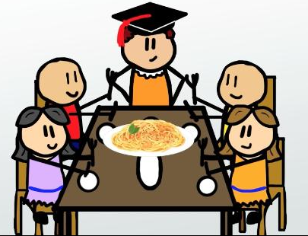
SPECIFIC MEMORY STRATEGIES
Rehearsal strategies
Low-Level Rehearsal Strategies
Reading over material a few times, saying it over and over again, or even copying it several times are examples of low-level rehearsal strategies.
2. High-Level Rehearsal Strategies
High-level rehearsal strategies such as outlining, predicting questions, and creating charts and concept maps involve elaborative rehearsal (repetition that involves making the information meaningful)

Slide 20
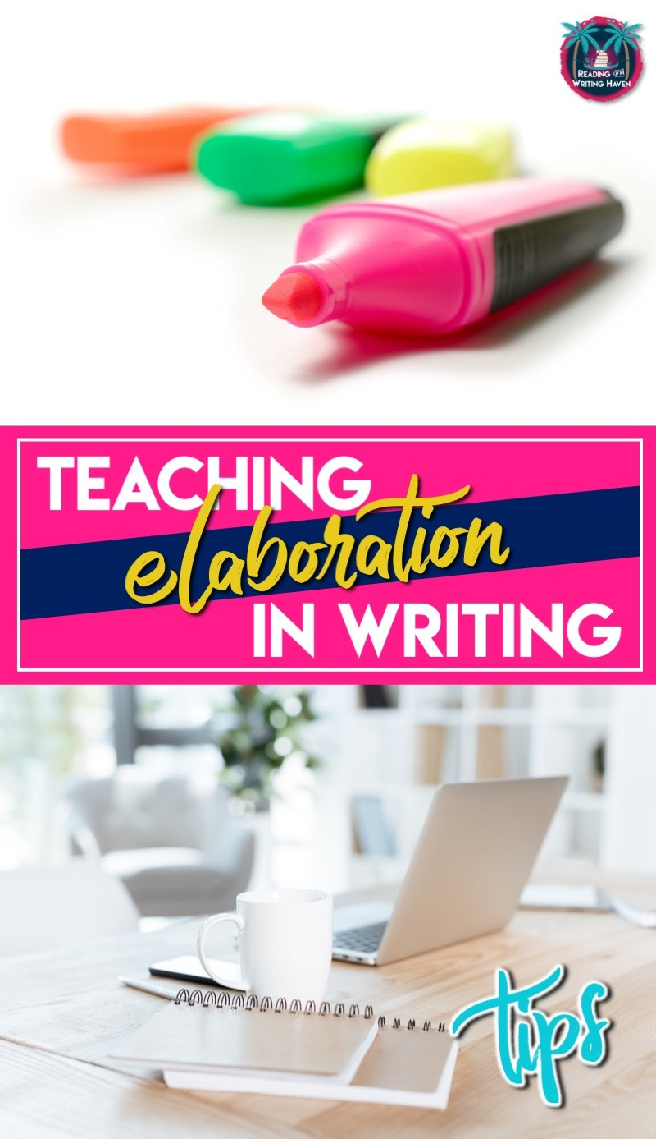
SPECIFIC MEMORY STRATEGIES
Elaboration strategies
Elaboration strategies involve expanding on the information, forming associations, or connecting new information to what you already know.
Paraphrasing, summarizing, explaining, answering questions, forming mental images, and using mnemonics (“ni-mon-iks”) are all elaboration strategies

Slide 21
SPECIFIC MEMORY STRATEGIES
Elaboration strategies
One of the chief advantages of elaboration strategies is that they help you create more associations with the material to be learned, thereby providing you with more routes for getting to the information during retrieval.

Slide 22
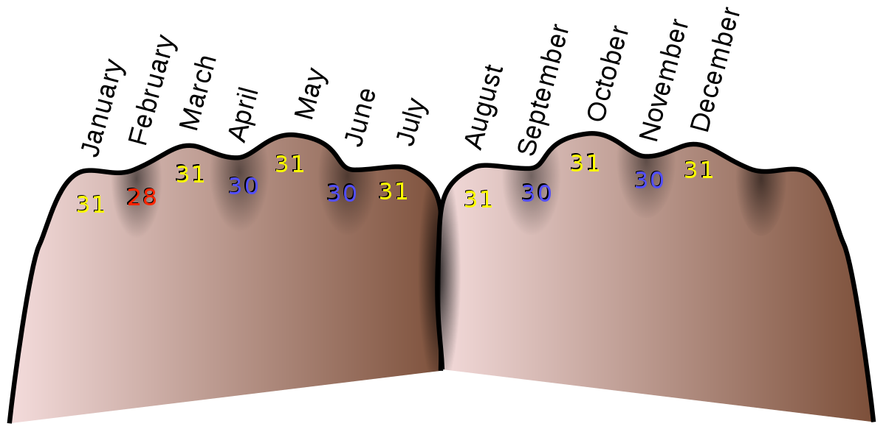
SPECIFIC MEMORY STRATEGIES
Elaboration strategies
Mnemonic devices or techniques often are referred to as memory tricks.
The advantage of mnemonic devices is that they form an association with the material, so if you remember the mnemonic, you remember the material.
Mnemonics provide an organizational framework or structure for remembering information that may not appear to have a structure of its own

Slide 23
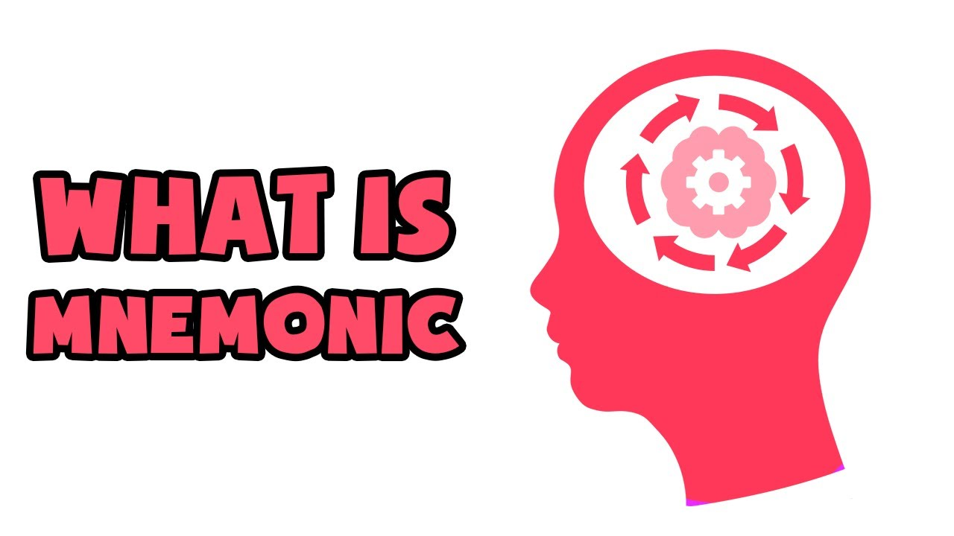
SPECIFIC MEMORY STRATEGIES
Elaboration strategies
https://www.youtube.com/watch?app=desktop&v=vM2GMfWbxKM

Slide 24
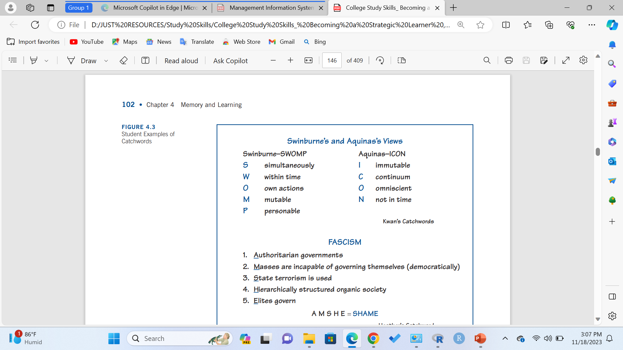
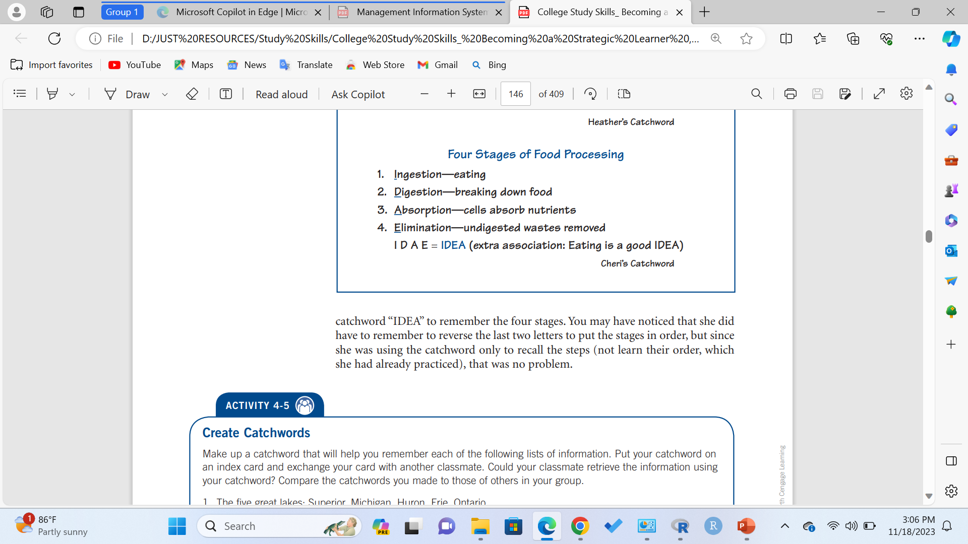
SPECIFIC MEMORY STRATEGIES
Elaboration strategies
Associations
Forming associations is always important when you’re trying to remember something. We use this technique every day.
Acronyms, or Catchwords
Acronyms are “words” that are made up of the
first letters of other words.

Slide 25
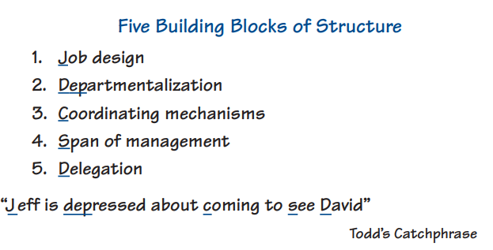
SPECIFIC MEMORY STRATEGIES
Elaboration strategies
Acrostics, or Catchphrases
Acrostics, or catchphrases as Langan called them, are phrases or sentences that are made up of words beginning with the first letters of other words
Acronyms, or Catchwords
Acronyms are “words” that are made up of the
first letters of other words.

Slide 26
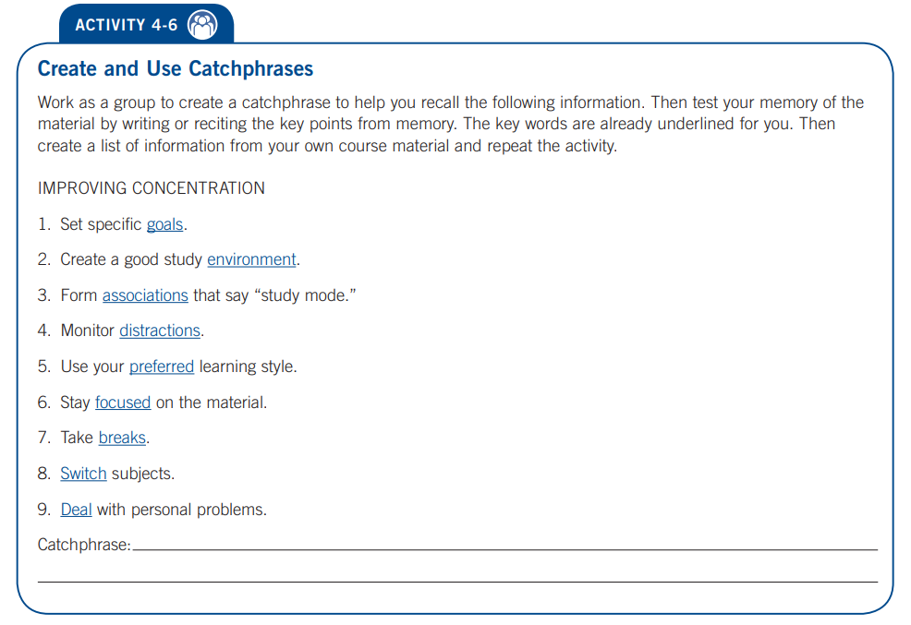

Slide 27

SPECIFIC MEMORY STRATEGIES
Organizational Strategies
Organizational strategies allow you to organize the information to make it easier to learn and recall.
Tasks such as listing, ordering, grouping, outlining, mapping, charting, and diagramming are all examples of organizational strategies

Slide 28
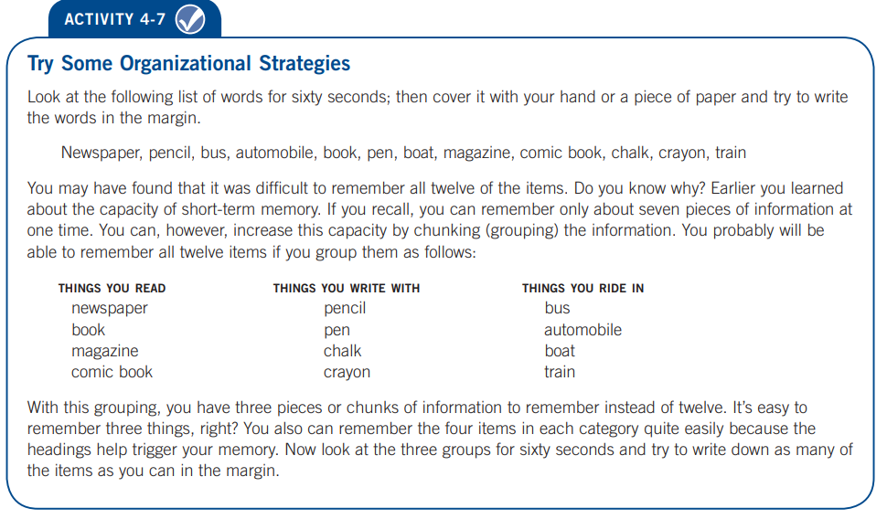

Slide 29
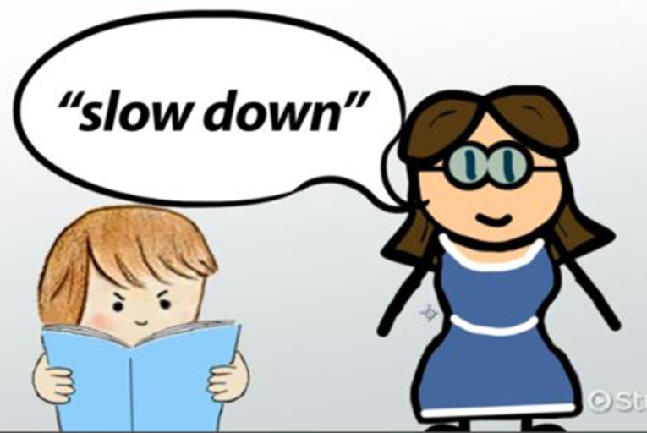
SPECIFIC MEMORY STRATEGIES
Comprehension Monitoring Strategies
Comprehension monitoring strategies allow us to monitor or keep tabs on our learning.
They help us monitor our progress in mastering the material and allow us to evaluate the effectiveness of the strategies that we use to gain that mastery.
https://study.com/academy/lesson/comprehension-monitoring-strategies.html

Slide 30

SPECIFIC MEMORY STRATEGIES
Affective and Motivational Strategies
Affective and motivational strategies are strategies that relate to your attitude, interest, and motivation toward learning.
They can influence how effectively you learn and remember information.
They help you keep up with your daily assignments and give you a sense of accomplishment at the end of the day.

Slide 31
SPECIFIC MEMORY STRATEGIES
Affective and Motivational Strategies
Your Attitude Toward Learning
Your attitude about learning the material can influence how well you’ll attend to it, organize it, and store it.
Monitoring Your Learning
Monitoring your learning also can be an effective motivational device. If you test
your learning by covering the material and trying to recite the information, you’ll be able to evaluate your storage and retrieval processes

Slide 32
Q & A
End of Session

